Slide 1




Obelisk
The high performance data-in/data-out platform
Notes:
Good morning everybody
I am part of a small team that focuses on researching, designing and developing cloud services and solutions, mostly driven by industry-demands.
Today I am going to tell you a little bit about Obelisk, which is our high-performance platform for ingesting data at large scale and having it queryable as soon as possible.

Slide 2



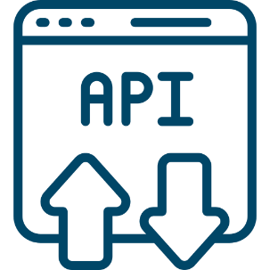


Cloud-Native
Timeseries data & events
Ingest data Query & stream data
High throughput
Scalable
Notes:
What is Obelisk?
Obelisk is a CloudNative solution that acts as a queryable data sink for high volumes of time-based data.
When we say time-based data, that of course includes the more traditional timeseries, but also event data that originates over time.
Obelisk has support for not only primitive data types like numbers, but also number arrays, Strings and structured data (like JSON strings). As long as the data has a timestamp, it can be ingested.
Obelisk was first developed for the City of Things project that started in 2016. The project wanted to investigate how hardware and software could be combined to create smart-city solutions. For that, a high performant IoT platform was required that could ingest all the different sensor data streams that were being captured from the many sensors placed throughput the city of Antwerp. The many projects that would follow also needed query and streaming access to that sensor data, to build new innovative applications on top.
Our answer to this was the very first version of Obelisk.
We knew from the start, that the requirements would only go up, so scalability was major factor from the start of the design process.
Since then, we’ve been improving, refining and sometimes even rewriting Obelisk to better suit the constantly more demanding requirements that are expected of the platform.

Slide 3
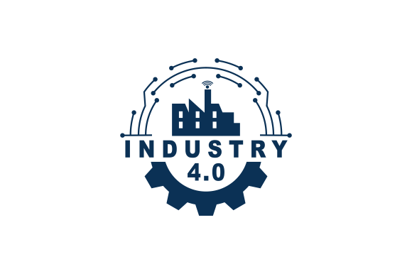

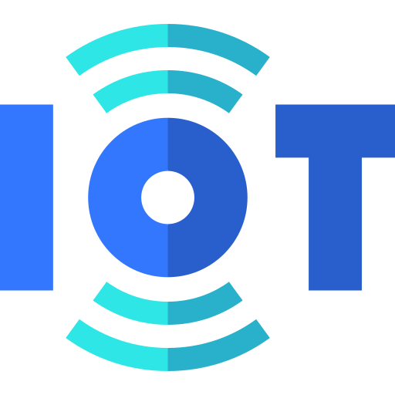
Use cases
Timeseries database
Alternative to: InfluxDB, Timescale, OpenTSDB/KariosDB
Smart City / IoT / Industry 4.0 platform
Multi-tenancy
Fine-grained access control
Geospatial component
Scalable data sink for event streams
E.g. datalake for post-capture ML processing
Notes:
So where is Obelisk useful?
1. A first use case would be as a general-purpose Timeseries database. It is an alternative to technologies such as InfluxDB, Timescale or OpenTSDB or KariosDB. Depending on your specific use-case, Obelisk might be a better fit
2. A second use case, is actually the original use case: as a Smart city, IoT or industry 4.0 platform: Obelisk is used to capture sensor data and to build applications that consume this data. Unique features that facilitate this: multi-tenancy: organize & isolate data in the context of different projects/consortiums
Fine-grained access control: restricted access to time ranges or labels (e.g. homelab use case)
Geospatial component: query data produced in a certain region/location/area
3. A third use case is to use Obelisk as pure data sink for event streams. Obelisk supports more than only numerical values, which widens the range of possible use-cases significantly. A typical more popular example of this is employing it as a datalake that can be used afterwards to run Machine Learning on.

Slide 4




Applications
City of Things
Smart Maintenance
mBrain
PortForward
IDLab testbeds (iLab.t)
HomeLab
OfficeLab
Notes:
Some applications of Obelisk in practice.
City of Things Described as a Testbed for Smart City IoT collaborative research in a realistic, city-wide setting. Obelisk was originally developed for CoT and served as one of the main technical drivers, functioning as a reliable data backend for most of the demos and prototypes.
Smart Maintenance Research project in the context of Industry 4.0 & predictive maintenance in collaboration with Flanders Make. Obelisk was used as a platform for capturing high volumes of sensor data produced during lab experiments with actual hardware testbenches that would run tests on large mechanical components like large ball bearings.
mBrain Context-aware health monitoring: application of ML algorithms to assess the activities, sleep and emotional state of the user based on physiological collected data through wearables. Obelisk is deployed to handle the large volumes of data produced by these wearables and to deal with the irregular connectivity intervals, resulting in bursty traffic and unpredictable loads on the infrastructure.
These first 3 projects have been defining projects for Obelisk. City of Things lay the basis, Smart Maintenance’s and mBrain’s requirements pushed beyond what was possible at the time and required us to improved, adapt and re-engineer parts of the platform to be even more scalable and accept larger bursts and higher throughputs.
Other projects
PortForward The project was set up to research a sustainable ecosystem for the European Port of the Future. Obelisk was used to built a multi-tenant interoperability layer (PoC) for sharing data in a Smart Harbor context.
IDLab testbed infrastructure (also known as iLab.t) HomeLab and OfficeLab: Both labs are fitted with many different sensors that constantly capture data and send it to Obelisk. Companies can then use these environments for a limited time and conduct experiments, after which they have queryable data in Obelisk that they can use as they see fit.

Slide 5
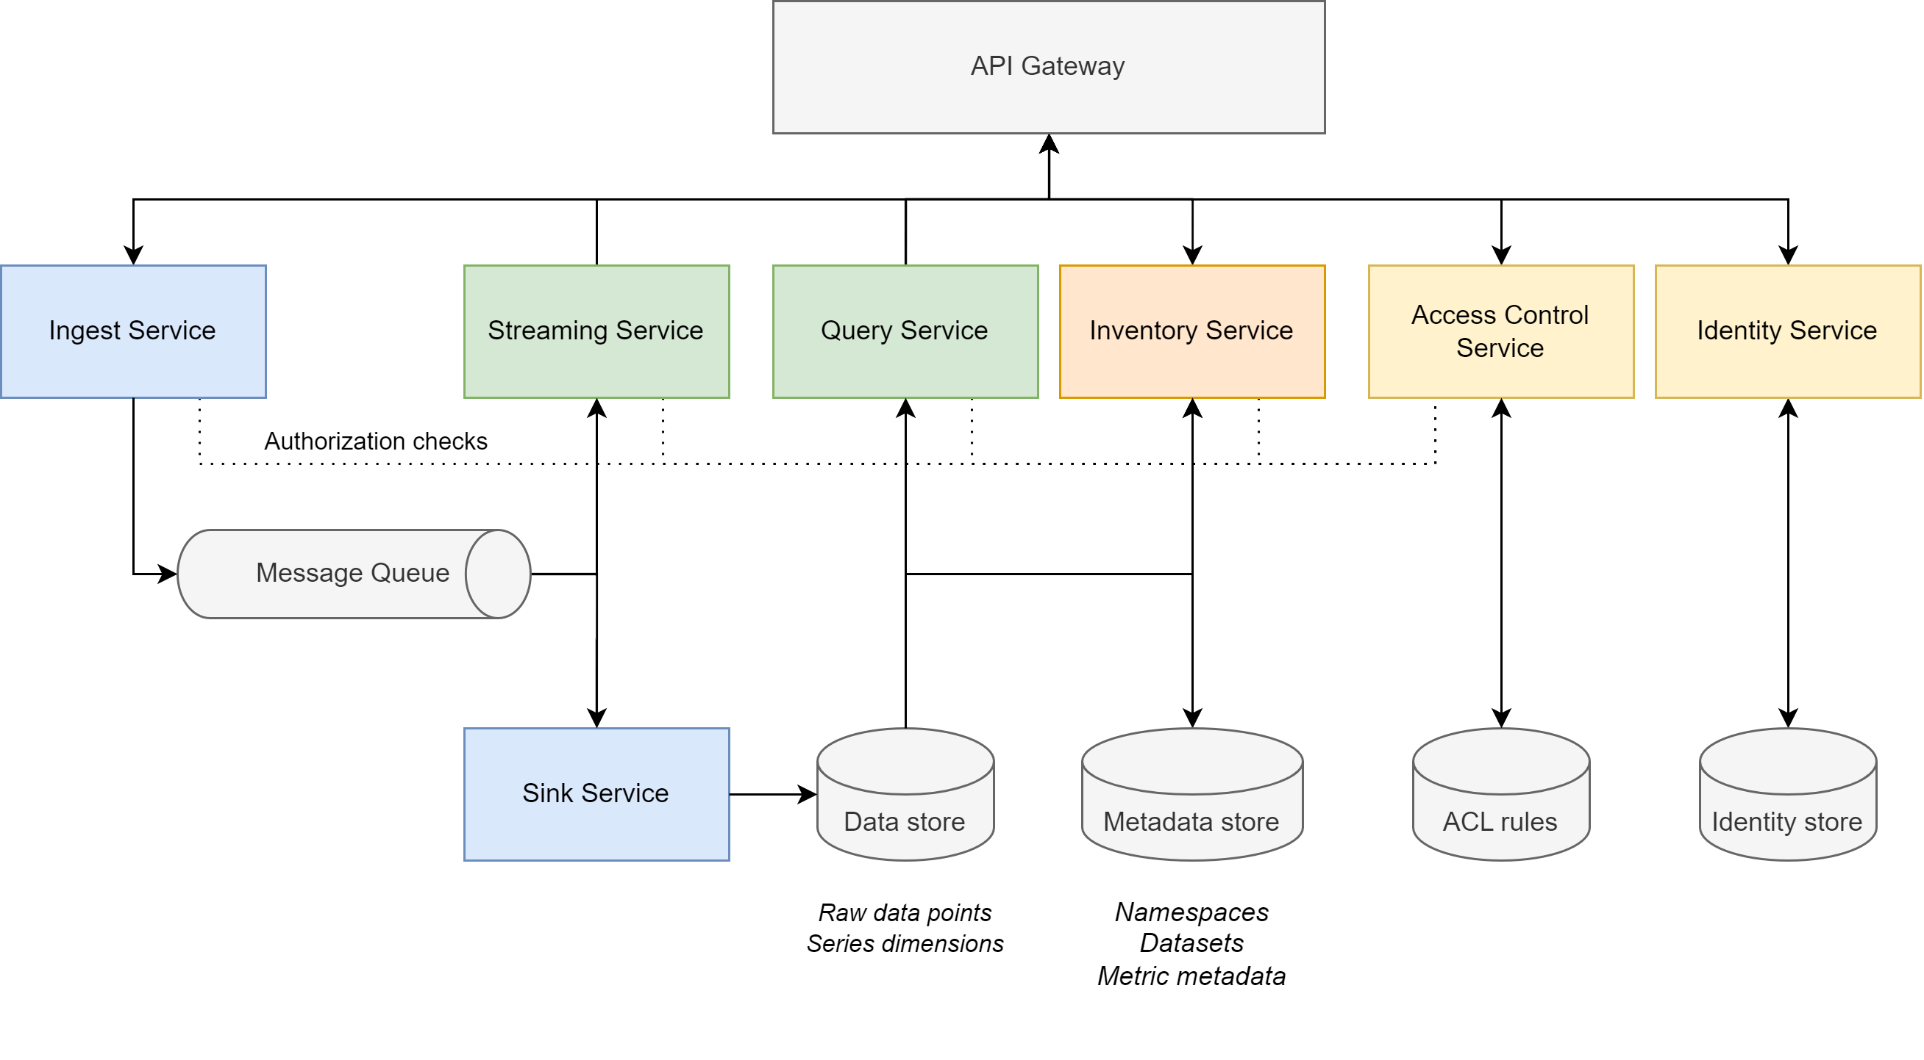
Architecture
Notes:
Obelisk is built with many different services, they are exposed through one common API gateway.
The arrows represent the flow of data. The simplest way would be to follow the whole path of data going in and back out.
Ingest Service
When Ingesting data: the HTTP API is used and data thus comes in through the API Gateway after which it reaches the Ingest Service. A few things happen here:
Authorization check: uses the Access Control Service to check if sending party is authorized to ingest data to the given dataset.
An array of data events is received:
Each event is (partially ) validated: e.g. correctly formatted timestamp etc
Each event is posted on the message queue (in parallel)
Message Queue
The message queue has 2 consumer paths:
Sink Service: This service batches events up to 100K batch size (for increasing db store operation throughput) or a smaller batch if 2 seconds have passed (to limit latency). These properties are configurable By horizontally scaling the sink-service, throughput can be increased (nr of instances is limited by the Kafka topic partition count)
Streaming Service: This is an outgoing service. Interested parties can subscribe to a dataset’s datastream through the HTTP API. As you can see, this is a near real-time stream of the data coming in, even before it is stored in the data store.
Query Service
Another way to access the data, is through the Query Service. Again using the HTTP API Gateway a request for data will be handled by the Query Service. This will use both the Data store and Metadata Store to find the request data and formulate a response.
Inventory Service
All extra information about Datasets, Namespaces, Metrics, etc is stored in the Metadata store and accessed through the Inventory Service. This metadata is again exposed via the HTTP API Gateway.
Access Control Service
This service, as said before will provide the other services with authorization checks on whether or not they can disclose data to the requesting party. This service will make its decisions based on a set of ACL rules.
Identity Service
This service manages identities required to perform Authentication with the platform.
Blue: Data IN
Green: Data OUT
Orange: Discovery / Inventory Management
Yellow: AuthN+Z

Slide 6
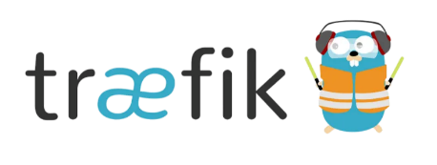
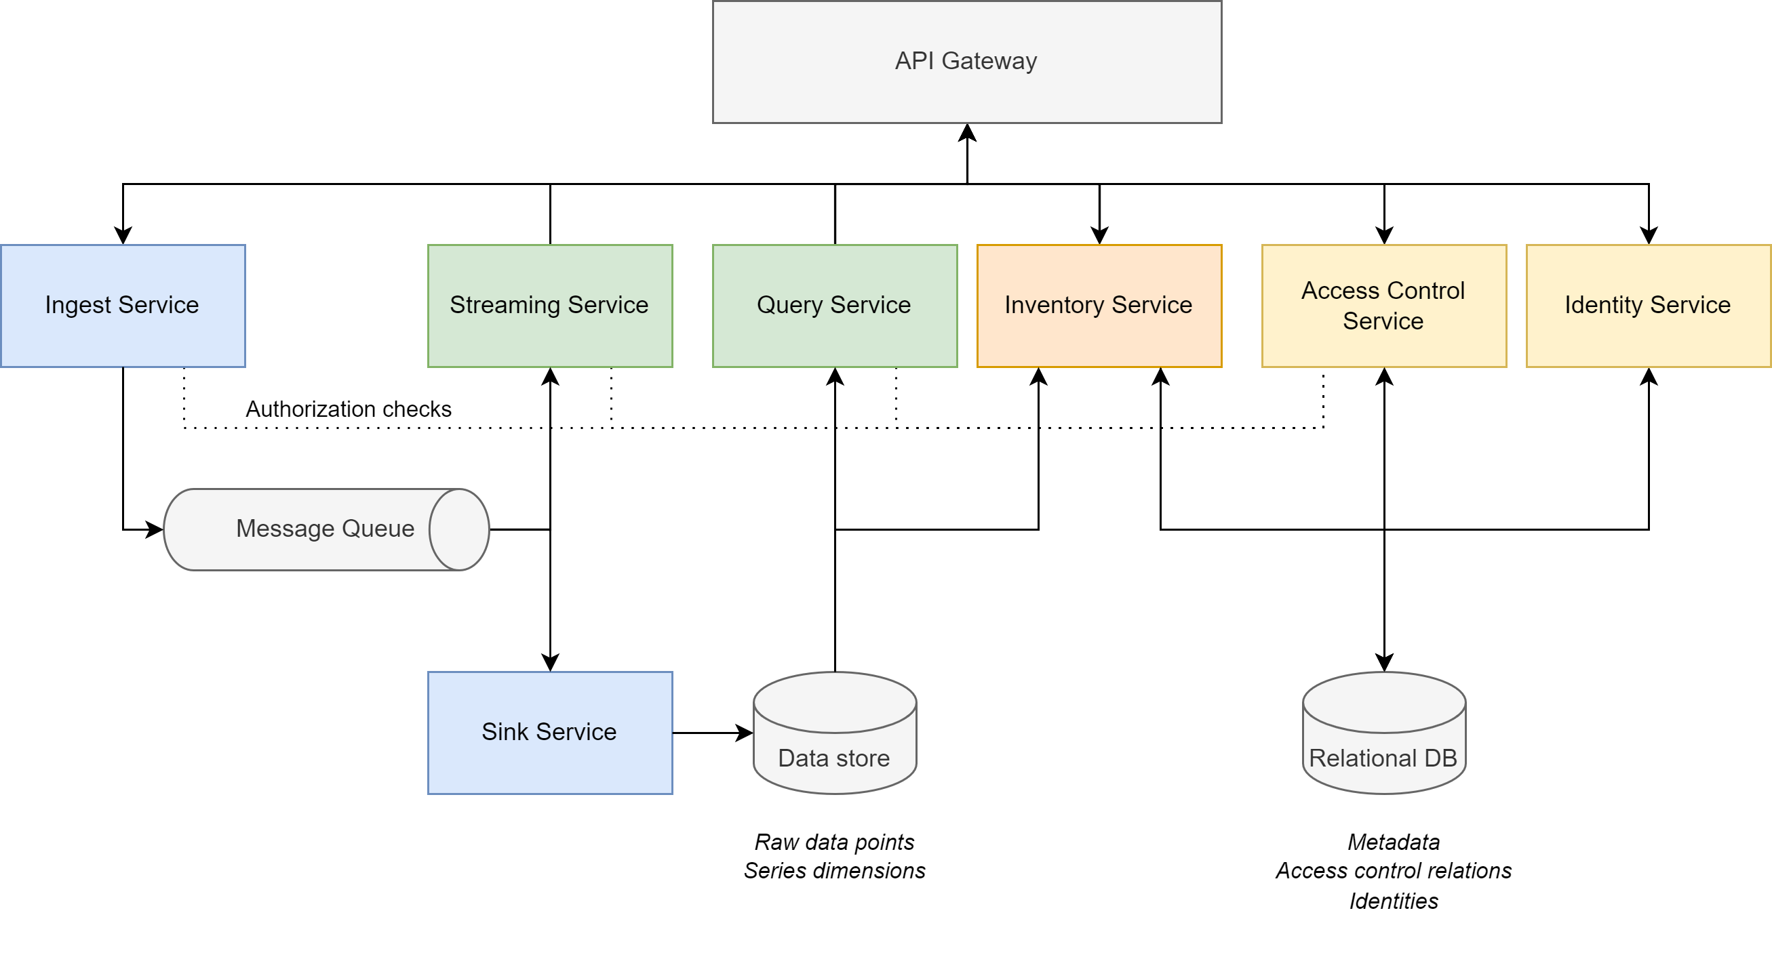
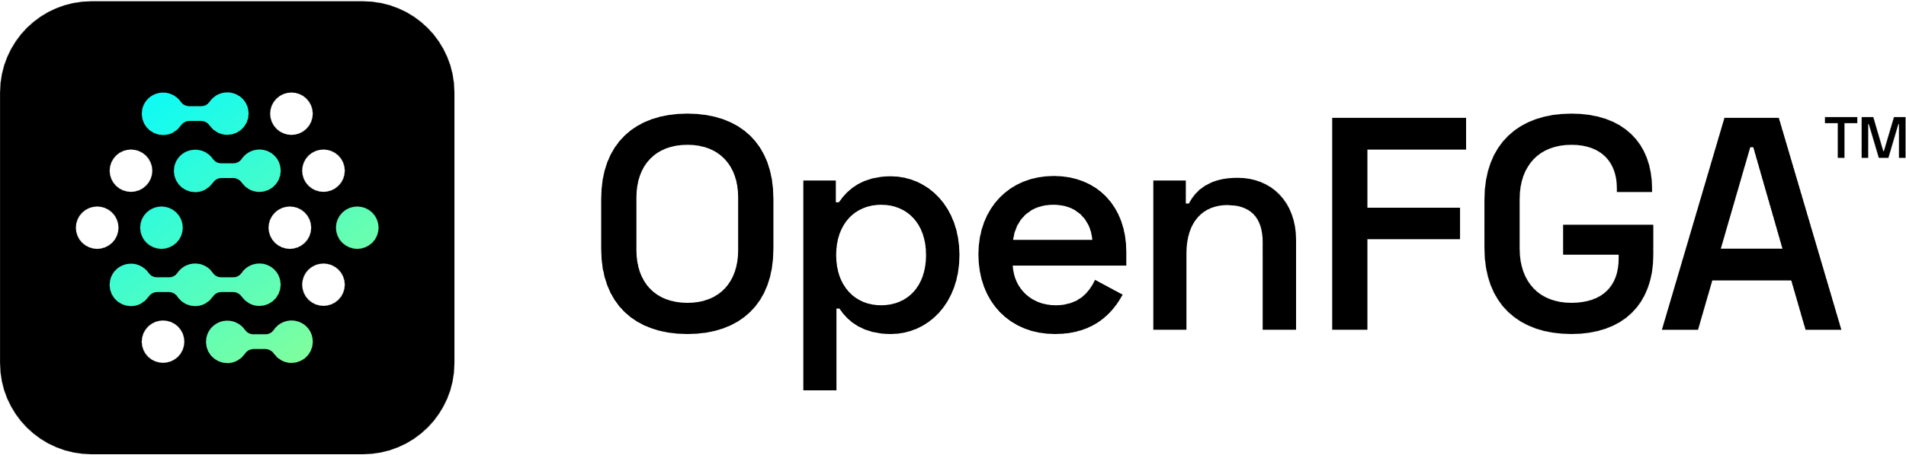
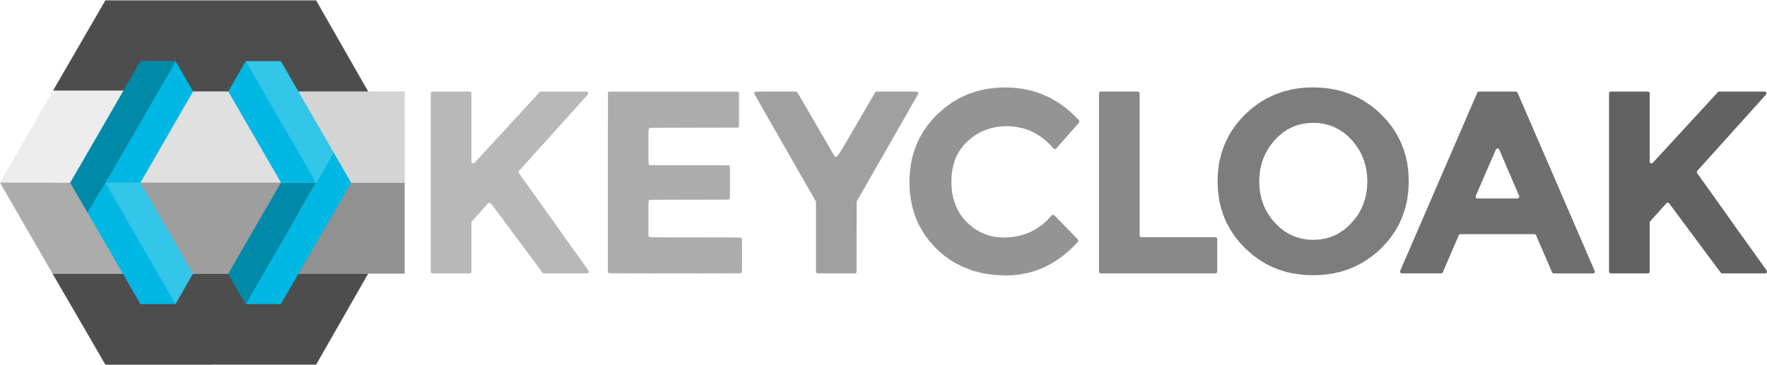
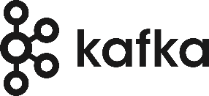
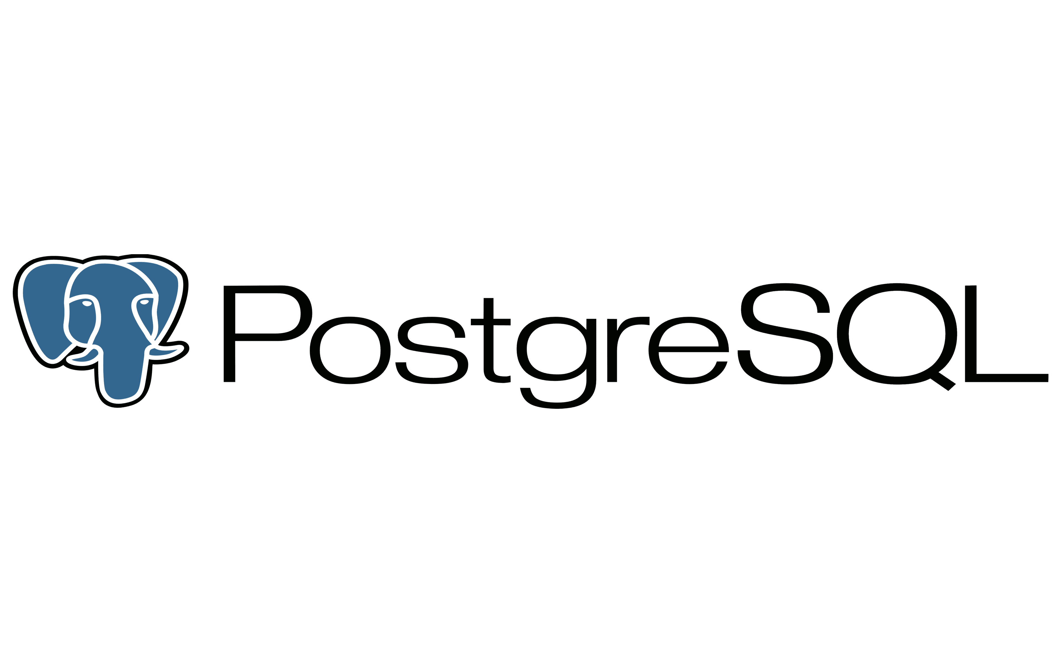


Technologies
Notes:
Notable change from the architecture:
The Metadata Store, ACL Rules and Identity Store are all provided by PostgreSQL, allowing us to keep the dependencies to a minimum.
Other technology choices:
Traefik as an API Gateway (k8s ingress)
Kafka as a message queue implementation
The Data store is provided by ClickHouse, which is an OLAP Column store (Online Analytical Processing) While ClickHouse is a general purpose OLAP store, careful consideration was put into the schema design for Obelisk with various optimizations for dealing with timeseries (e.g. index selection, compression codecs).
OpenFGA as an Access Control Service Relationship-based access control. Implementation of the Zanzibar paper by Google. (Zanzibar handles authorization for YouTube, Drive, Google Cloud and all of Google's other products)
Keycloak as identity service Open Source Identity and Access Management solution, originally develop by Red Hat. It is well maintained, follows latest security recommendations and specifications. Allows us to leaves security to the experts..
Obelisk Services are developed with Quarkus and are all JVM-based.

Slide 7


CloudNative first
CloudNative Dependencies (CNCF)
Best practices in cloud deployment & operation
Full usage of Kubernetes constructs such as
Ingress (Traefik)
Secrets & ConfigMaps
Readiness & liveness probes
Obelisk
Microservice based-deployment
Fail-fast
Independent boot order
Notes:
Obelisk is built with a CloudNative first approach:
Existing technologies that Obelisk uses are all on the CNCF Landscape
In both deployment and operations we try to leverage best practices in cloud
We are using the full range of Kubernetes constructs as much as possible
Ingress to divert incoming requests to the proper services, without them needing to be aware of that
Secrets and ConfigMaps to store sensitive and common configuration
Readiness and liveness probes to check the health and lifecycle of all running services
Obelisk itself is also developed with these cloud concepts in mind:
Although we have a monorepo (small team), CI/CD pipeline is set up such that we deploy into individual microservices. (while still being able to run a monolith deployment for dev and testing)
Fail-fast approach: counting on Kubernetes to bring a new instance of the service up in case of failures
Independent boot order: thanks to fail-fast strategy and proper microservice abstraction, we have no boot order issues with many booting services
CNCF: the open source, vendor-neutral hub of cloud native computing. They gather projects that adhere to the cloud native definition. Which is basically pledging to use best practices in cloud deployment and operation.

Slide 8

HTTP APIs
Data
Ingest: HTTP POST
Query: HTTP GET
Request-based: Accept: application/json
Streaming: Accept: text/event-streaming
Inventory / Management
CRUD on resources
Extensive documentation is a requirement
Notes:
Developer friendliness is key for Obelisk
Our whole API is HTTP based and documented in OpenApi 3.0 spec
Obelisk comes with inventory/management APIs built-in.
Data can be sent with HTTP POST and queried with HTTP GETs. Normal HTTP Responses or Listening to a stream of data can be done with a simple HTTP Accept header.
Inventory/management API is simply Create/Remove/Update/Delete on resources
We see extensive documentation as a requirement to success, and thus an active issue that we keep on improving on as much as possible.

Slide 9
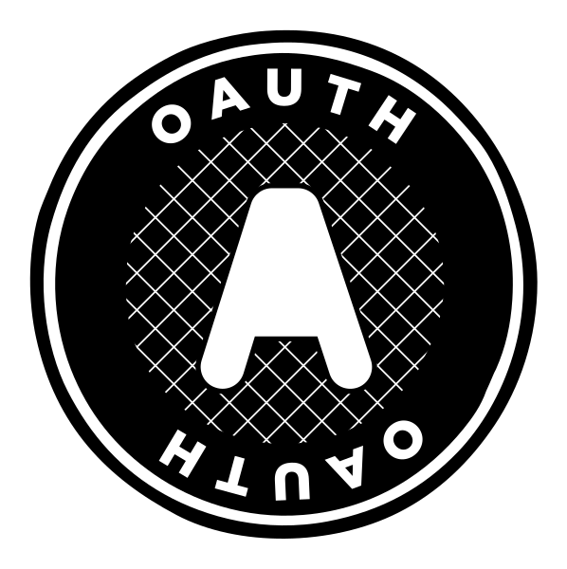
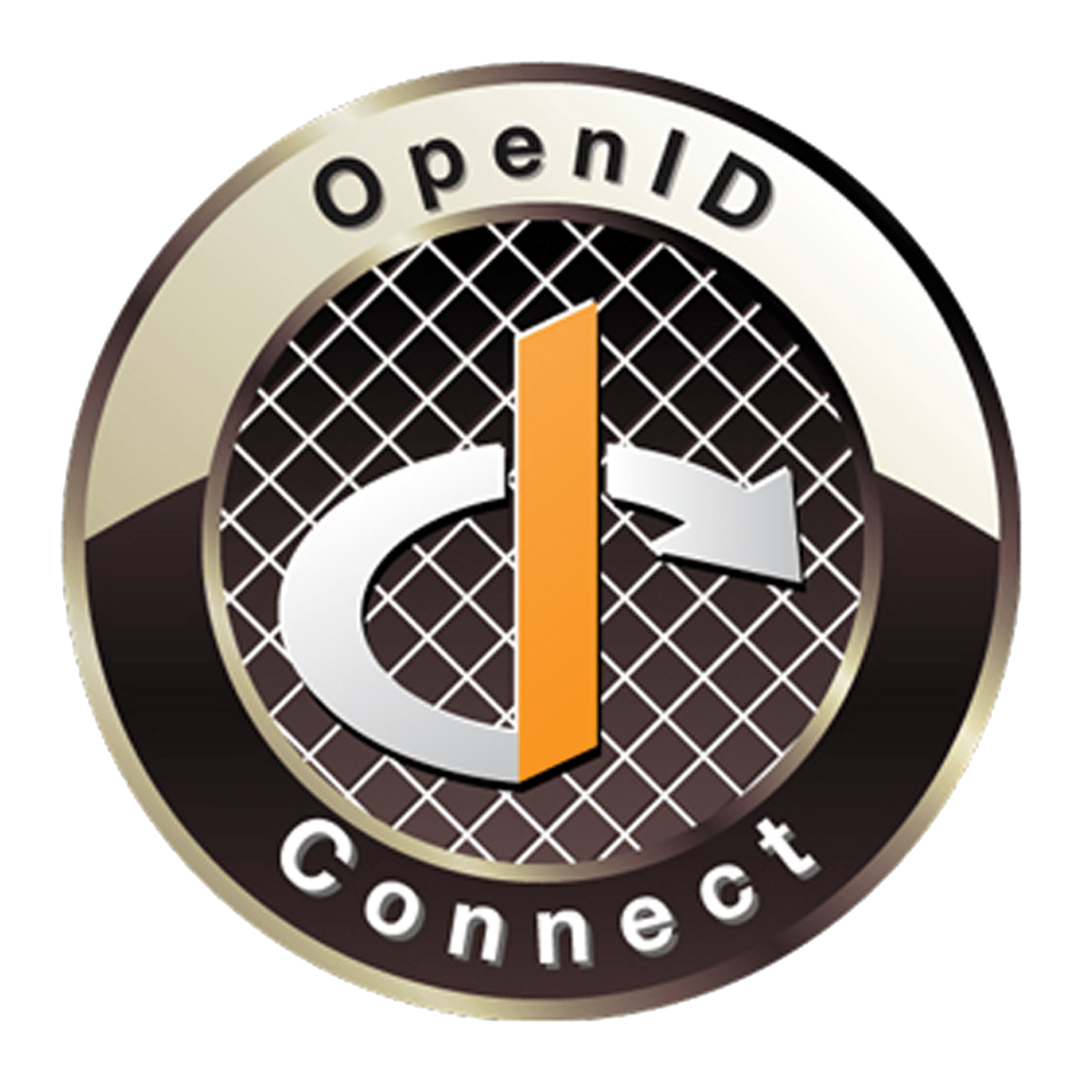
Security and authorization
Keycloak
OAuth 2.0
OpenID Connect 1.0
Moving to Keycloak (OAuth 2.1 spec)
OpenFGA: access control on dataset level
Obelisk can go further (data attribute filtering)
Data attribute filter dimensions
Time-based
Geographical
Labels
Notes:
As briefly mentioned before, Obelisk uses Keycloak as an Identity solution.
The very first version of Obelisk already used Keycloak. It was chosen for its excellent support of OAuth 2.0 and OpenID Connect 1.0 specifications. Throughout the version bumping we’ve dropped Keycloak once, due to the authorization options not being a perfect match. We then implemented our own authentication but based on the same specifications.
Now we are re-introducing Keycloak because of a few key benefits and circumstances:
Keycloak is well maintained by the developers
Keycloak follows security vulnerabilities and patches known attack vectors
Keycloak already follows the new OAuth 2.1 specification which is in draft status
Keycloak also acts as an Identity Broker (for various other identity providers): we don’t need to store credentials!! (big plus)
The limitations we had with Keycloak access control were based on
KC’s resources-based rules and how that didn’t really fit with contextual API endpoints
Inter-dataset relations that inherit rights of the parent dataset, that could not be modelled.
Namespace access control: that implies transitive access rights to the children, which was hard to model.
However, now that we use OpenFGA for access control, this problem is a non-issue. Keycloak is a pure Authentication layer, authorization is then handled by OpenFGA
OpenFGA’s Relationship-based access control system allows us to enforce all these difficult access control patterns up until the level of a dataset. Obelisk allows access control going even deeper than that, but it is no longer handled by OpenFGA then, the lasts steps (which are data attribute level enforcements) are handled by the services themselves in the form of filters.
Data attributes that can be used for access control on this deeper level are…

Slide 10


Deployment & operation
Deployed on Kubernetes (since v1.6) using Helm Charts
Obelisk Helm Chart:
All core services
No external dependencies
Maintained and tested alongside codebase
Full stack install with Helmsman:
Helm charts as code
Obelisk + dependencies
Automated deployment and management
Install, upgrade and rollback entire setup
Notes:
We have been deploying and operating Obelisk on Kubernetes since Kubernetes v1.6
We have quickly moved on from deploying plain Kubernetes manifests to more manageable Helm Charts (Helm: Package manager for Kubernetes)
Alongside the codebase we maintain a Helm Chart for the core Obelisk services. External dependencies are installed separately.
Many of these dependencies could also be swapped out for equivalent cloud services (Kafka -> Azure Event Hubs, hosted ClickHouse, etc.).
Most of the external dependencies are installed using Helm Charts as well (except for ClickHouse which we install using an Operator)
Currently we use Helmsman to manage installation and upgrades of the entire Obelisk software stack (core + dependencies). Helmsman uses a Desired State File which describes the different applications, their config and chart versions. Through Helmsman we can then install all charts in one go and rollback the entire state in case of failure.
In the future we would like to streamline this deployment by developing an Operator or wrapper Helm chart which installs and manages both Obelisk services and the dependencies.

Slide 11
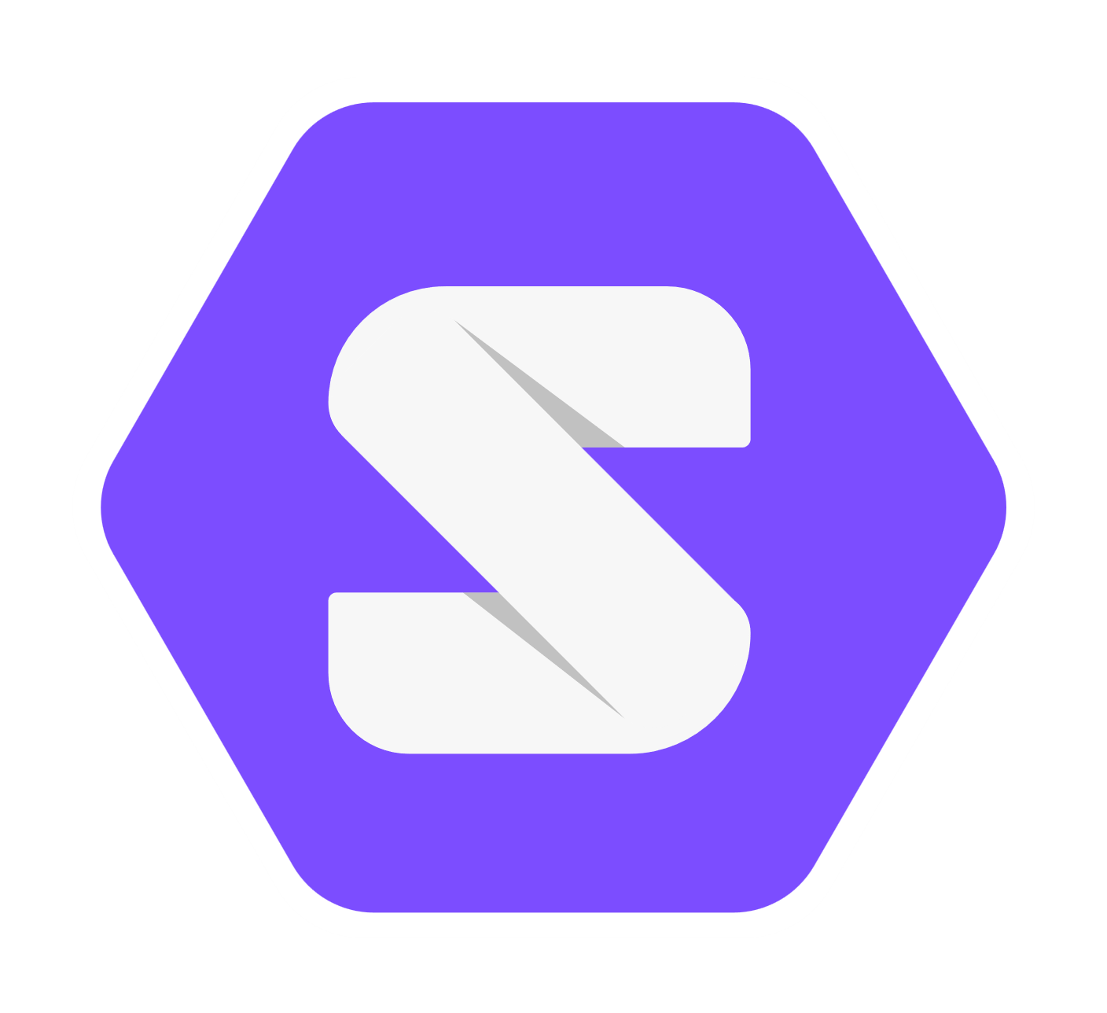

Obelisk & Data standards
IDSA
SOLID
Obelisk might participate on data plane level
Expose time-series data (solid-compatible)
Notes:
So what about Data standards?
In the past efforts have been made to support various data standards, including:
Exposing Metadata (Catalog) information via DCAT-AP
Providing additional interfaces that comply with the FIWARE NGSI/NGSI-LD data interoperability specifications.
Although it is relatively easy to provide working prototypes, implementing and maintaining a high level of spec compliancy proved too difficult to realize with a small team of three people. Especially for a specification such as NGSI(-LD), with its design by committee nature, there was often a significant mismatch with Obelisk, a platform that evolved from a pragmatical perspective and was continuously evaluated and improved in the context of real use-cases & applications.
Currently our strategy is to support standards via 1st party or 3rd party extensions, instead of implementing possible integrations as part of the core platform. Possible interesting candidates for future support (via extensions):
IDSA (International Dataspaces): Obelisk might participate in the IDSA architecture on the data plane level.
Solid (Web decentralization initiative led by Sir Tim Berners Lee): expose Obelisk time-series data in a Solid compatible way (IDLab is also involved in the SolidLab Flanders project)

Slide 12
Obelisk’s evolution
IoT platform for City of Things
Focus: IoT
Storage: InfluxDB
Message-bus: Kafka
Focus: stability / ease of use
Storage: Sharded InfluxDB
Message-bus: Kafka
Version 2
Focus: self-service management
& scalability
Storage: Clickhouse
Message-bus: Pulsar
Version 3
Focus: edge case scalability
high throughput
uptake for ML use case
Storage: Clickhouse
Message-bus: Kafka
Version HFS
Focus: open source
scalability
maintainability
Storage: Clickhouse
Message-bus: Kafka
Obelisk Core + Services
Notes:
As has been mentioned a few times already. Since the start of the City of Things project in 2016, Obelisk has been through quite a few revisions already.
That’s why I thought it might be interesting to quickly go over these major redesigns.
As stated before, it started with the City of Things IoT platform version. The focus here was clearly on the IoT use case, and the main data storage solution was a single InfluxDB instance.
Our chosen message bus technology was Kafka.

Slide 13
Obelisk’s evolution
Focus: IoT
Storage: InfluxDB
Message-bus: Kafka
IoT platform for City of Things
Focus: stability / ease of use
Storage: Sharded InfluxDB
Message-bus: Kafka
Version 2
Focus: self-service management
& scalability
Storage: Clickhouse
Message-bus: Pulsar
Version 3
Focus: edge case scalability
high throughput
uptake for ML use case
Storage: Clickhouse
Message-bus: Kafka
Version HFS
Focus: open source
scalability
maintainability
Storage: Clickhouse
Message-bus: Kafka
Obelisk Core + Services
Notes:
With projects like Smart Maintenance the scalability was being put to the test and we did a full redesign to version 2.
Focus here was stability when scaling up and ease of use by employing lessons learnt from usage feedback of the first version.
Storage was still provided by InfluxDB, but multiple shards. However the pricing on a sharded InfluxDB solution was too steep for our use-case, which lead us to develop our own custom sharding solution on top of many single InfluxDB instances.
The message bus technology stayed the same with Kafka.

Slide 14
Obelisk’s evolution
IoT platform for City of Things
Focus: IoT
Storage: InfluxDB
Message-bus: Kafka
Focus: stability / ease of use
Storage: Sharded InfluxDB
Message-bus: Kafka
Version 2
Focus: self-service management
& scalability
Storage: Clickhouse
Message-bus: Pulsar
Version 3
Focus: edge case scalability
high throughput
uptake for ML use case
Storage: Clickhouse
Message-bus: Kafka
Version HFS
Focus: open source
scalability
maintainability
Storage: Clickhouse
Message-bus: Kafka
Obelisk Core + Services
Notes:
Managing onboarding of many new projects proved too much work for our small team. This in part led us to implement a third version which was able to scale even better, thanks to the new column store ClickHouse. This version had self-service management which allowed onboarding by the users themselves.
Our message bus technology evolved to Pulsar. At the time this seemed a good contender for Kafka, with a more modern and developer friendly API and better documentation,
Being researchers, it is important to evaluate new and cutting edge techology, so this seemed like the perfect opportunity.

Slide 15
Obelisk’s evolution
IoT platform for City of Things
Focus: IoT
Storage: InfluxDB
Message-bus: Kafka
Focus: stability / ease of use
Storage: Sharded InfluxDB
Message-bus: Kafka
Version 2
Focus: self-service management
& scalability
Storage: Clickhouse
Message-bus: Pulsar
Version 3
Focus: edge case scalability
high throughput
uptake for ML use case
Storage: Clickhouse
Message-bus: Kafka
Version HFS
Focus: open source
scalability
maintainability
Storage: Clickhouse
Message-bus: Kafka
Obelisk Core + Services
Notes:
Projects like mBrain, again sought the limits of our current ingest burst potential. An experimental side version was developed that would allow High Frequency Storage, an edge case, all be-it one that significantly put the current platform under stress.
Storage technology stayed the same with ClickHouse.
The message bus technology switched back to Kafka. It was more mature by then, and we saw many industrial partners having a managed Kafka instance in their used cluster/cloud offerings.

Slide 16
Obelisk’s evolution
IoT platform for City of Things
Focus: IoT
Storage: InfluxDB
Message-bus: Kafka
Focus: stability / ease of use
Storage: Sharded InfluxDB
Message-bus: Kafka
Version 2
Focus: self-service management
& scalability
Storage: Clickhouse
Message-bus: Pulsar
Version 3
Focus: edge case scalability
high throughput
uptake for ML use case
Storage: Clickhouse
Message-bus: Kafka
Version HFS
Focus: open source
scalability
maintainability
Storage: Clickhouse
Message-bus: Kafka
Obelisk Core + Services
Notes:
The final version is the one we’ve been working on for the past months. This version is what I am presenting today. Although it isn’t live yet, we are very close to launching it.
One of the main motivations apart from the obvious increase in performance and scalability was having a good base to open source and having a strategy for maintainability.
We focused on a lean and mean Obelisk Core with the bare minimum of required features. All other features would move to the Obelisk Services layer.
Our storage is still handled by ClickHouse, because we are very happy with its performance.
Our message-bus is still Kafka: it is still the best fit for industrial partners.

Slide 17
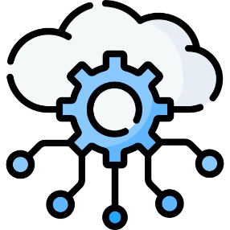

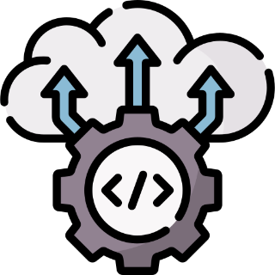
Future plans
Small scale deployment / federation
More data extraction options
Simplified deployment: lowering the barrier to entry
Notes:
We have some future plans for next iterations, of what would be nice to have features.
Small scale deployment / federation There are many ways in how this could be useful. It could act as an edge computing case, wherein small-scale obelisk instances are deployed close to the data sources, and they pre-aggregate data, before sending it to a main obelisk cluster. This could be interesting because of limited resources on the edge, or limited bandwidth in the uplink, or expensive data transfer costs on the uplinks. It could be beneficial to have those small-scale deployment not needing a cluster to run and being able to run database-less (on the file-system)
More data extraction options Mostly more ways to query data
Jupyter notebook integration
Interactive dashboards
Integrations with other existing technologies
Simplified deployment process Installing Obelisk involves following an extensive guide, lots of manual setup and verification. Goal: concise configuration file and an installation one-liner
Exploring development of an Operator which fully manages the Obelisk setup (core services + external dependencies)
Research track running into development of a generic Operator for data-driven applications, this operator would mainly monitor installation and perform config bootstrapping (e.g. setting the various connection strings for databases, message bus, etc.)

Slide 18
Obelisk Core vs Services
Obelisk Core
Faster development cycle
Less dependencies when moving forward
Maintainability
Prevents feature creep
Open source license (Apache 2.0)
Obelisk Services
1st party extensions
3rd party extensions
Separate licensing possible
Obelisk Core
Obelisk Services
Notes:
As I said, the newest version that will be released soon is called Obelisk Core.
This Obelisk Core was important for us for a few reasons. We have a small team working on this. Keeping Obelisk Core to the bare necessities allows us :
To have faster development cycles
Move forward without dragging many dependent services along that have to be updated every time we add a new feature to the platform.
Keep it maintainable for our team.
Prevents feature creep in the Core platform by offloading project-requested extras to Obelisk Services
The Obelisk Core will always have all required components to function properly and will always be open source (Apache 2.0 license)
Obelisk Services are a shell around the Core. They can add more interfaces, using the Core. They can come in the form of data-generators, or processing plugins, etc.
The licensing of these services is the choice of the developer. We will ourselves release some functionality as an Obelisk Service and that might very well be open source.
However a 3rd party might develop an Obelisk Service and license it however they see fit.
With this separation and the Obelisk Core going full open source we hope to build a community that provides us with important feedback and reports on any issues they might find.
It also allows companies that want to use Obelisk to always have the option to fork and adapt to their needs.

Slide 19



Questions?
https://github.com/idlab-discover/obelisk
https://idlab-discover.github.io/obelisk-next
thomas.dupont@ugent.be
Notes:
The first link on screen is the GitHub repository of the current public version of Obelisk (which right now, is still v3, but will soon be the newest version)
The second link is the landing page for the next version of Obelisk that is coming soon. It will also have a link below to these slides.

